Slide 1
Available as an add-in for outlook

Slide 2
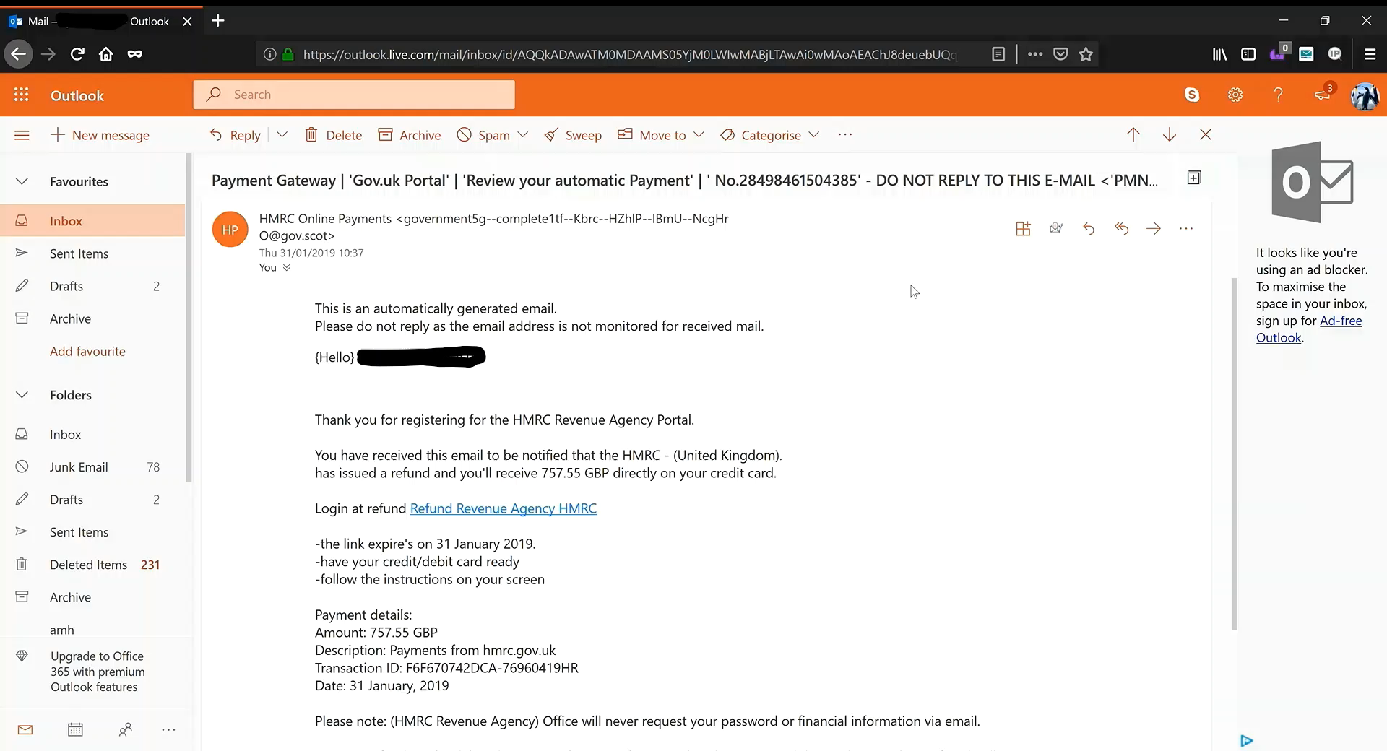

Slide 3
Log-in to the dashboard

Slide 4
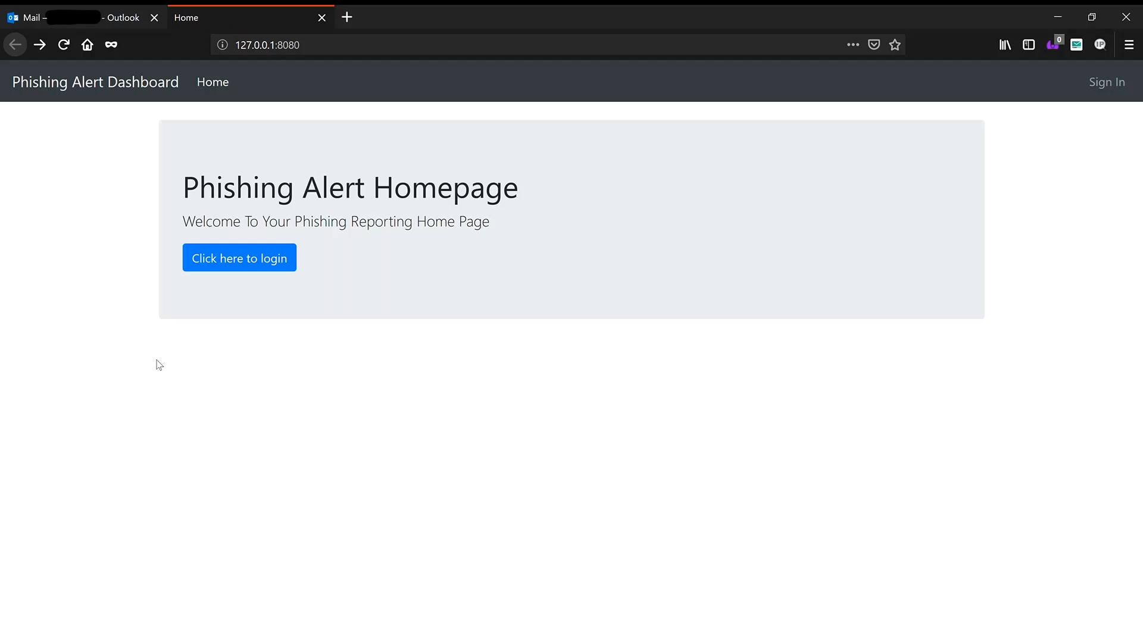

Slide 5
View emails

Slide 6
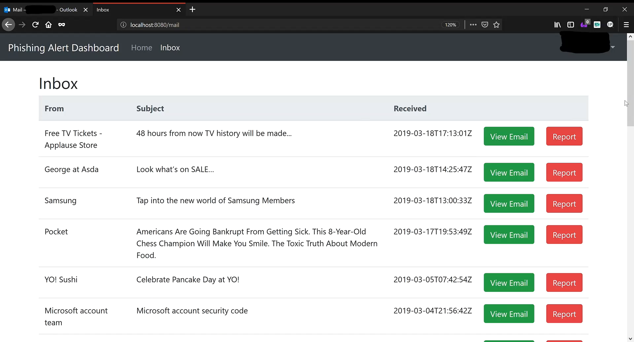

Slide 7
Report emails in a click

Slide 8
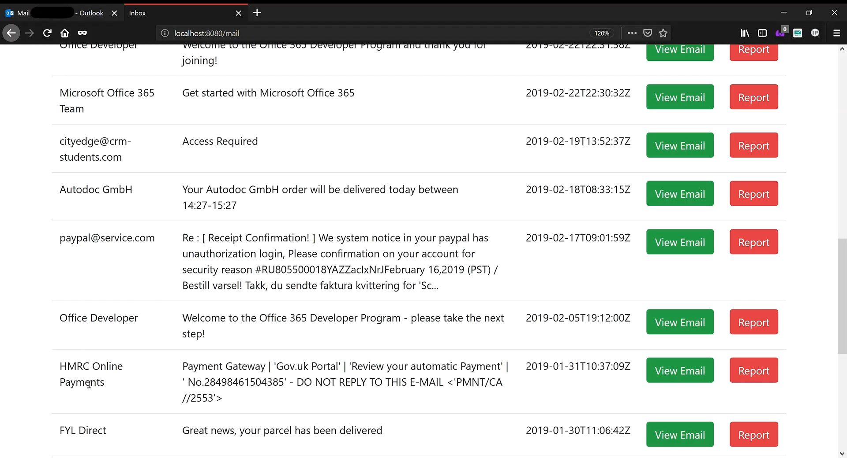

Slide 9
Done!

